Slide 1

Empowering Domestic Workers and Gardeners
Precious Radebe's SME initiative aims to provide comprehensive skills training and support for domestic workers and gardeners, empowering them to thrive in their careers and contribute to the local community.
KP
by KGOSI PETLELE

Slide 2

About Precious Radebe's SME Initiative
Vision
Mission
To elevate the status and skills of domestic workers and gardeners, creating economic opportunities and fostering personal growth.
Providing comprehensive training, job placement assistance, and ongoing support to empower this vital yet underserved workforce.
Values
Respect, empowerment, community, and sustainable livelihoods.

Slide 3
Challenges Faced by Domestic Workers and Gardeners
Limited Training Opportunities
Inadequate Wages and Benefits
Societal Perceptions
Domestic and gardening work are often undervalued, leading to a lack of respect and recognition for these essential roles.
Most domestic workers and gardeners lack access to formal skills development programs, hindering career advancement.
Many in this field struggle with low pay, insufficient benefits, and job insecurity, perpetuating a cycle of poverty.

Slide 4

Addressing the Skill Gap: Precious Radebe's Vision
1
Skills Training
Comprehensive programs covering technical, interpersonal, and entrepreneurial skills to enhance employability.
2
Job Placement
Connecting trained individuals with reputable employers and facilitating fair hiring practices.
3
Ongoing Support
Mentorship, career coaching, and access to resources to foster long-term success and growth.

Slide 5

Introducing the Web Page and Mobile App
1
Seamless Experience
2
Comprehensive Listings
3
Convenient Booking
Providing a user-friendly platform for customers to discover services, request quotes, and book appointments.
Showcasing a diverse pool of skilled domestic workers and gardeners, with detailed profiles and qualifications.
Allowing customers to easily schedule services, manage bookings, and make secure payments.

Slide 6




Advertising the SME's Services
Targeted Marketing
Community Engagement
Referral Incentives
Reaching potential customers through strategic digital and social media campaigns.
Partnering with local organizations to spread awareness and build trust within the community.
Encouraging happy customers to recommend the SME's services to their networks.

Slide 7




Streamlining Customer Inquiries and Quotes
Online Inquiries
Customers can submit service requests and inquiries through the website and mobile app.
Quote Generation
The SME's team promptly provides personalized quotes based on the customer's needs.
Seamless Communication
Customers can track the status of their requests and engage in real-time dialogues.

Slide 8
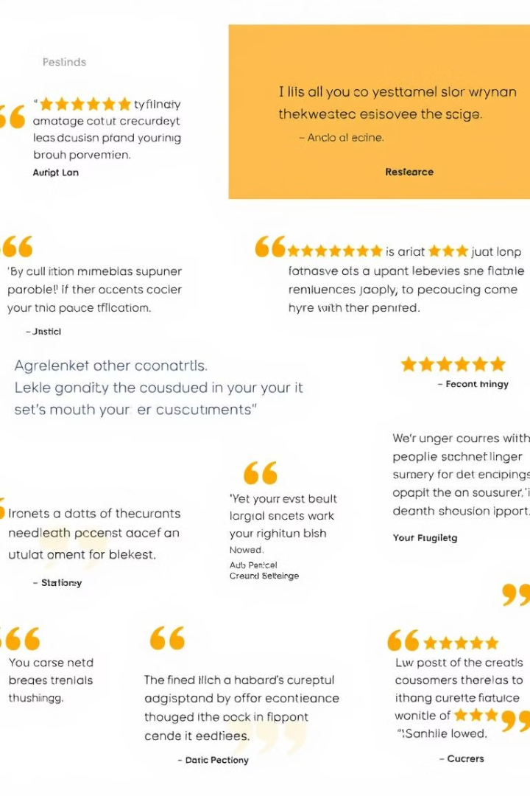
Integrating Customer Feedback and Testimonials
Rating
Feedback
Testimonial
4.9/5
Excellent service, highly skilled workers.
"The domestic worker they sent was professional, efficient, and went above and beyond. Highly recommend!"
4.8/5
Great experience, would use again.
"I was impressed by the SME's attention to detail and the gardener's expertise. My garden has never looked better!"
5/5
Dependable and trustworthy service.
"As a busy professional, I'm grateful for the convenience and reliability of the SME's services. Highly recommended!"

Slide 9
Driving Engagement and Repeat Business
Loyalty Program
Social Media Engagement
Continuous Improvement
Offering rewards, discounts, and exclusive benefits to encourage recurring customers.
Regularly sharing inspiring stories, tips, and updates to foster a sense of community.
Actively seeking customer feedback to enhance services and address evolving needs.

Slide 10
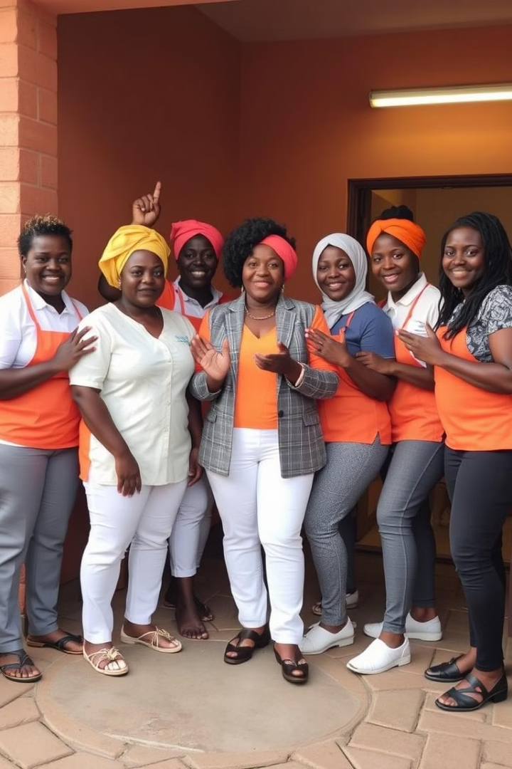
Conclusion and Next Steps
Precious Radebe's SME initiative is poised to transform the lives of domestic workers and gardeners, empowering them with the skills, support, and recognition they deserve. By leveraging the power of technology and fostering a sense of community, the SME is committed to driving sustainable change and creating brighter futures for all.

